Slide 1
Examining Online Discussion on Male’s HPV Vaccination
SU Youzhen 55543403
Chu Tse Hang 53030350
FAN Fei 55529250
WANG Sai 54939553

Slide 2
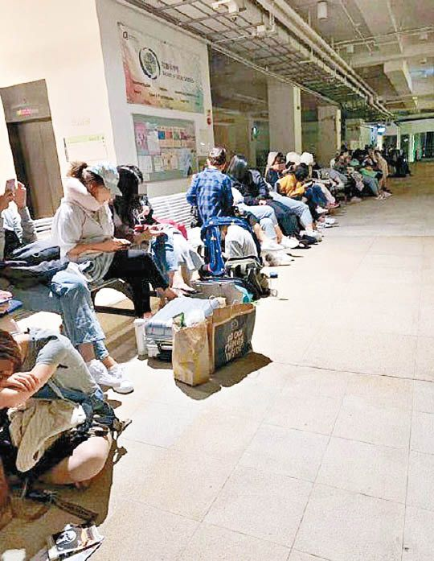
01
INTRODUCTION
特價HPV針浸大300人通宵排隊攞籌
Why this topic?
Personal experience: daily life observation
The latest news reporting about HPV vaccine injection in HK universities & online discussion
News source and photo credit: Yahoo News HK https://bit.ly/2zfoL3N

Slide 3
Discrepancy between ideal and reality...
In a National Health and Nutrition Examination Survey (NHANES, 2013-2014) of 1,868 men from ages 18 to 59, the prevalence of genital HPV infection was 45.2%, but only 10.7% were vaccinated against HPV.
The 2016 National Immunization Survey-Teen (NIS-Teen) shows that 56% of boys received at least the first dose, compared with 65% of girls.
Notes:
Low injection rate among males
In this cross-sectional study of the National Health and Nutrition Examination Survey (NHANES) 2013-2014, the overall genital HPV infection prevalence among 1868 men was 45.2%, which appears to be widespread among all age groups, with a low HPV vaccination rate of 10.7%.

Slide 4
02
RESEARCH QUESTION
How many online posts about HPV vaccination in male and female on reddit?
1
What are the most commonly used keywords when discussing HPV vaccination in male and female? (Is there gender difference in the keyword use?)
2
What is the general attitude toward male HPV vaccination?
(pro-/anti-/neutral)
3
What are the main arguments when discussing male HPV vaccination?
4
Notes:
The amount of online posts about HPV vaccine injection in male and female
The most commonly used keywords when discussing HPV vaccine injection in males and females
The general attitudes toward male HPV vaccine injection (pro-/anti-/neutral)
Possible reasons/arguments relating to male vaccination presented in their discussion

Slide 5
03
PREVIOUS WORK REVIEW
Extant Studies | Data Source | Method | Research Focus
Contents of Japanese Pro- and Anti-HPV Vaccination Websites: A Text Mining Analysis (2018) | Google & Yahoo!. JAPAN | Texting Mining Analysis | Content comparison between pro-HPV vaccine injection websites and anti-HPV vaccine injection websites
Readability Comparison of Pro- and Anti-HPV-Vaccination Online Messages in Japan (2017) | Google & Yahoo!. JAPAN | Japanese Text Readability Measurement System (JTRMS) ANOVA Tukey’s test | Relationship between message claim and authors’ expertise
Mapping the Anti-vaccination Movement on Facebook (2017) | Facebook | Social Network Analysis Gender Modeling Topic Modeling Text Analysis | Anti-HPV vaccination movement: networked properties of anti-vaccination communities & types of anti-vaccination discourses and social footprints
Mapping Information Exposure on Social Media to Explain Differences in HPV Vaccine Coverage in the United States (2017) | Twitter | Supervised Machine Learning Topic Modeling | Correlation between socioeconomic indicators and HPV vaccine-related information coverage
Notes:
Extant researches about online discussion relating to HPV vaccine injection have been commonly conducted in U.S. and Japan.
Method Summary:
Online search on search engines (e.g. Google) + texting mining analysis
Online search on microblog platform (e.g. Twitter) + supervised machine learning + topic modeling
Online search on social networking site (e.g. Facebook)+ social network analysis + gender modeling + text analysis
Research Focus:
Content comparison between pro-HPV vaccine injection websites and anti-HPV vaccine injection websites
Relationship between message claim and authors’ expertise
Correlation between socioeconomic indicators and HPV vaccine-related information coverage
Anti-HPV vaccination movement: networked properties of anti-vaccination communities & types of anti-vaccination discourses

Slide 6

Data Mining Process?
Bitter and Sweet Feeling!!!

Slide 7




04
DATA MINING PROCESS
Data source
Data mining
approaches
Keywords
Failure case:
web scraping
{“Male HPV Vaccine” OR “Boy HPV Vaccine”}
{“Female HPV Vaccine” OR “Girl HPV Vaccine”}
American social news aggregation and discussion website
#3 most visited website in U.S. and #6 in the world
Successful story:
API
Title, URLs, number of comments, user id
Notes:
To collect:
Male：All forum posts and comments together with online users’ descriptive information have been collected.
Female：All forum posts together with online users’ descriptive information have been collected.

Slide 8
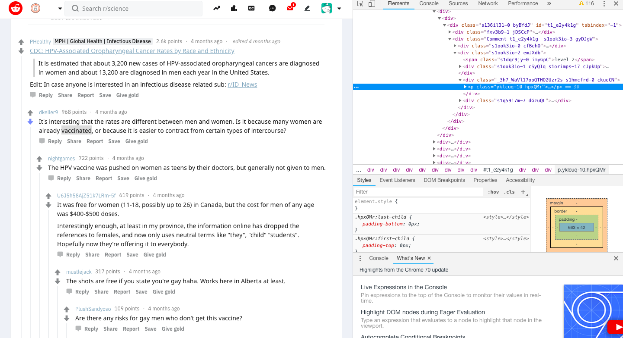
04
DATA MINING PROCESS
Notes:
To collect:
Male：All forum posts and comments together with online users’ descriptive information have been collected.
Female：All forum posts together with online users’ descriptive information have been collected.

Slide 9
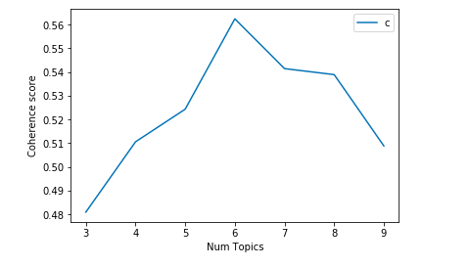
05
DATA ANALYSIS
Data Cleaning
Data Pro-processing
Topic modeling
Remove “space”, “punctuation”, “non-English characters”
Lowercase, lemmatization
Remove stopwords and specific words (“deleted” and “removed”)
Make bigrams
Create dictionary
Create corpus
Create TDF
Build LDA model: Gensim and Mallet
Validate the number of topics : Calculate coherence score
Select optimal topics
Interpret and label topics:

Slide 10
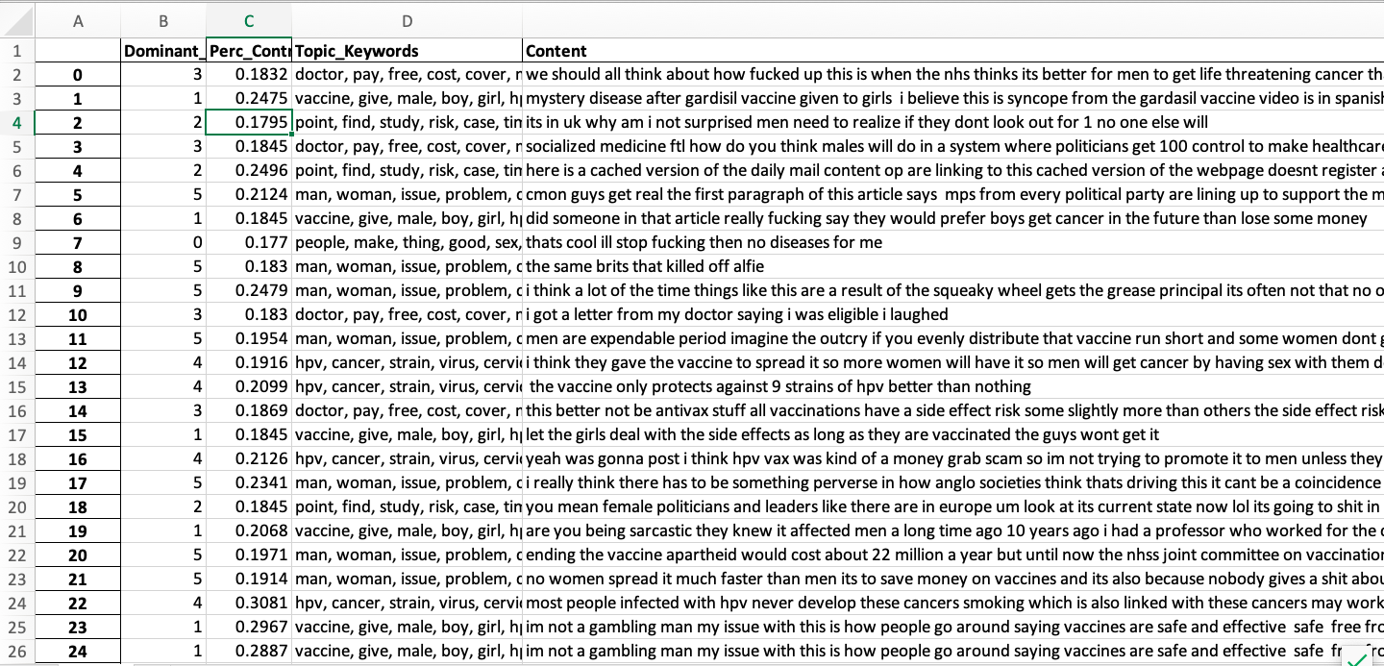
05
DATA ANALYSIS

Slide 11
06
RESULTS
1
How many online posts about HPV vaccination in male and female on reddit?

Slide 12
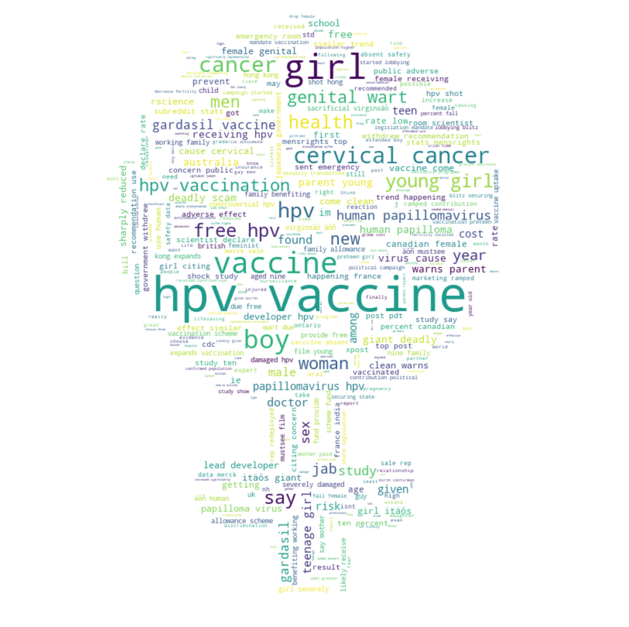
06
RESULTS
What are the most commonly used keywords when discussing HPV vaccination in male and female? (Is there gender difference in the keyword use?)
2

Slide 13
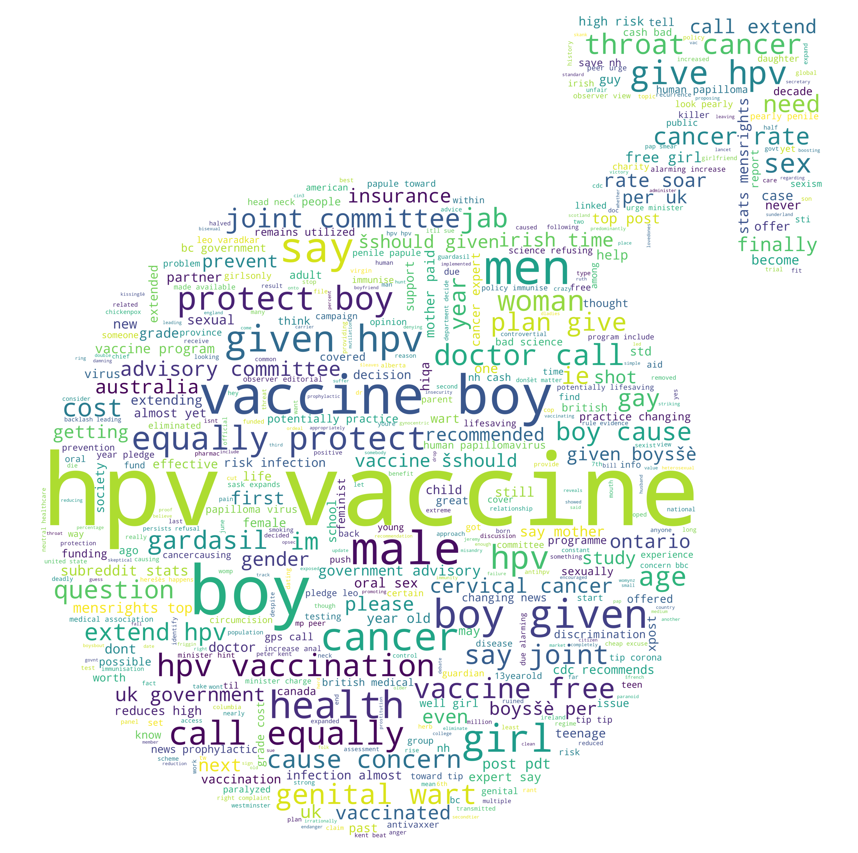
06
RESULTS
What are the most commonly used keywords when discussing HPV vaccination in male and female? (Is there gender difference in the keyword use?)
2

Slide 14
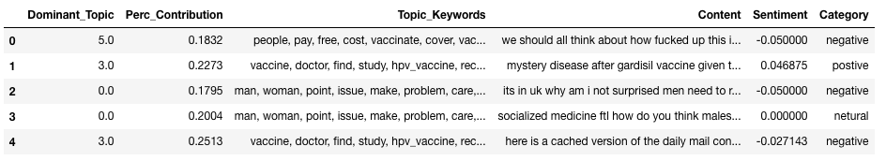
06
RESULTS
3
What is the general attitude toward male HPV vaccination?

Slide 15
06
RESULTS
4
What are the main arguments when discussing male HPV vaccination?
Topic | Associated Words
Recommendation for boys to take HPV vaccine as girls | Vaccine, give, male, boy, girl, hpv_vaccine, vaccinate, age, vaccination, reason, female, benefit, child, recommend, protect, Gardasil, effect, effective, parent, vaccinated
Debate on gender difference on HPV vaccination | Man, woman, issue, problem, care, feminist, gender, fuck, treat, group, argument, work, support, great, shit, person, world, big, small, dont_think
Cost and policy regard with Male’s HPV vaccine | Doctor, pay, free, cost, cover, money, work, shot, government, Year, live, insurance, health, treatment, state, provide, medical, side_effect, Canada, country
Relationships between cancer and HPV infection | Hpv, cancer, strain, virus, cervical_cancer, disease, wart, test, risk, population, type, prevent, spread, infection, partner, chance, common, protect, body, genital_wart
Argument on risks and negative effects of HPV vaccine | Point, find, study, risk, case, time, post, number, show, read, question, link, rate, comment, high, research, fact, edit, article, source

Slide 16
07
DISCUSSION

